Slide 1
Pre-Natal Testing
Catherine Coats, D.O.
September 26, 2012

Slide 2
What we’re going to talk about…
Prior to Pregnancy
First Trimester Testing
Second Trimester Testing
Third Trimester Testing
Decisions and Choices

Slide 3

Prior to Pregnancy
Assumption: Health Choices
  Quit Smoking, Drinking, Drugs
  Ideal Body Weight—Healthy Diet
  Up-To-Date Vaccinations

Slide 4

40 Weeks
10 Lunar Months
  266 days!
First Trimester
  LMP to 14 Weeks
Second Trimester
  14 to 28 Weeks
Third Trimester
  28 to 40 Weeks

Slide 5

First Visit
History
  Family
  Medical
  Surgical
  Obstetric
  Social
  Religious
  Ethnic
  Cultural

Slide 6

First Visit
Physical
  Vital Signs
    Height and Weight
    Blood Pressure
    Heart Rate
    Temperature
    Respirations
  Head to Toe
    Pelvic Exam
    PAP
    Cultures
    Measurements

Slide 7
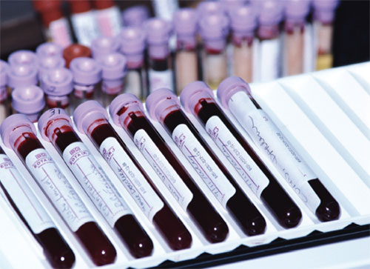
Initial Blood Work
Recommended Tests:
  Complete Blood Count (CBC)—Red Cells, White Cells, Platelets
  Blood Type—Antibody Screen
  Syphilis Testing (RPR)
  Hepatitis B (A & C, if needed)
  HIV
  German Measles (Rubella)
  Thyroid Hormone (TSH)
Potential Others:
  Chicken Pox (Varicella)
  Toxoplasmosis (Cats)
  Parvovirus
  Blood Chemistry
  Genetic Testing
    Cystic Fibrosis—Optional*
    Sickle Cell (African Descent)

Slide 8
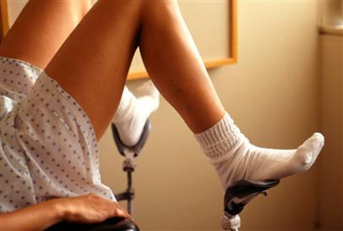
Other Recommended Tests
PAP
  Cervical Cancer
  HPV
Urinalysis
  Kidney Function
  Drug Screen
Cultures
  Gonorrhea
  Chlamydia

Slide 9
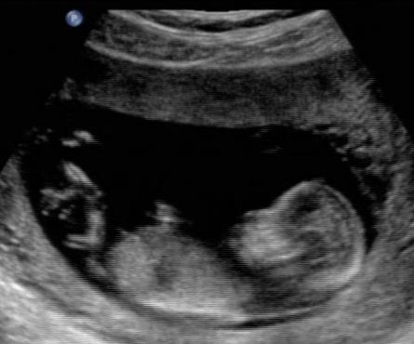
First Ultrasound
Between 6-12 Weeks
  Viability
  Accurate Due Date
  Twins?
  Anomalies

Slide 10
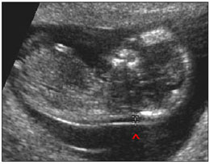
Optional Ultrasound
Nuchal Translucency—Measurement
  Between 11-13 weeks
Maternal Blood Testing
Combined data will estimate risk of chromosomal anomalies
-For example, 1:10 vs. 1:10,000 risk of Down Syndrome
-Trisomy 21
-Trisomy 18
-Trisomy 13
-Others
-Risk of False Positive/Negative
*Personal Decision
…Now what?

Slide 11
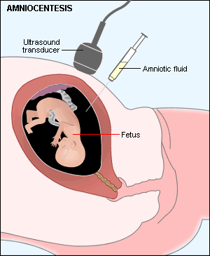
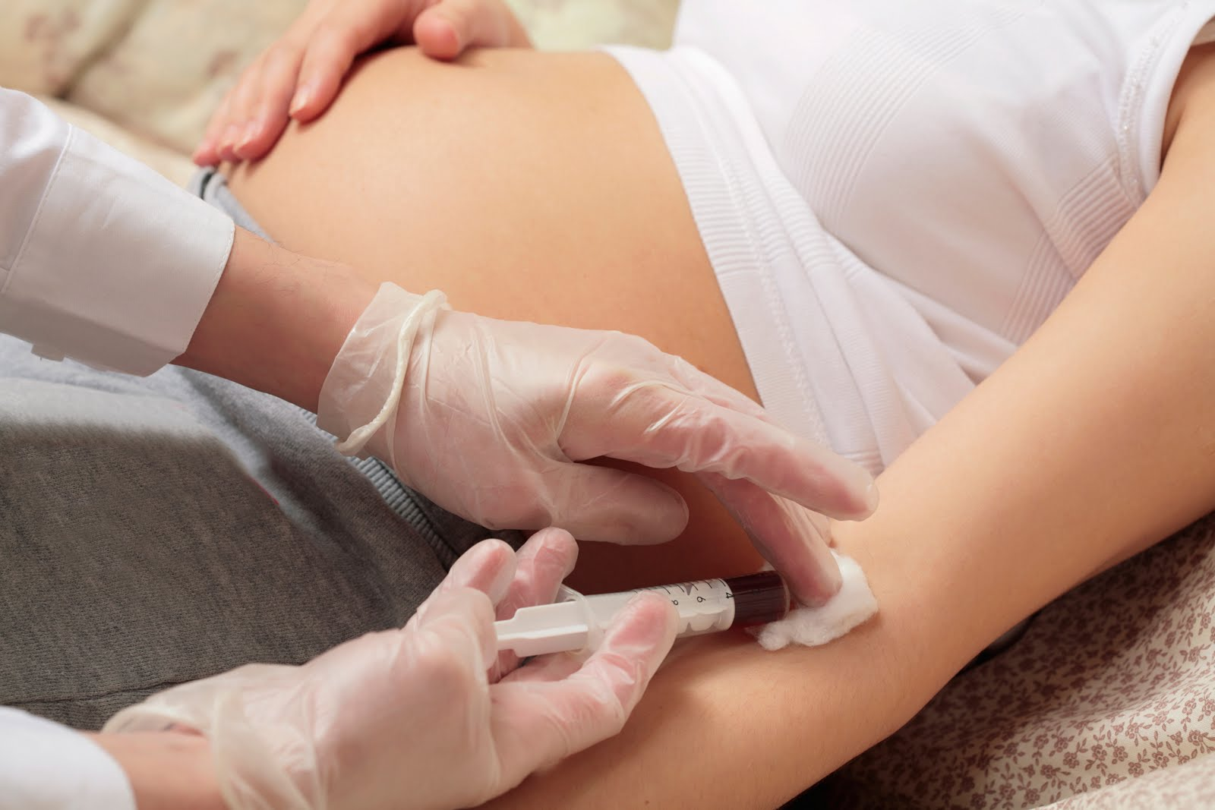
What’s Next?
Amniocentesis
NEW Blood Test
1:200 risk of procedure
Tests all baby’s chromosomes
MaterniT21™ PLUS Test
Tests Trisomies 13, 18, 21*

Slide 12
Second Trimester
Monthly Check-Ups continue
Blood Tests
  αFP (Spina Bifida and other defects)—15-20 weeks
    Can also add chromosome testing, if missed in 1st tri.
  Gestational diabetes testing—26-28 weeks
    1 hour/50 gram glucose challenge
    3 hours/100 gram glucose challenge
  Type and antibody screening (again!)
    Rh negative moms need Rhogam
  CBC (again!)
    Checking for anemia of pregnancy
    Platelet count

Slide 13
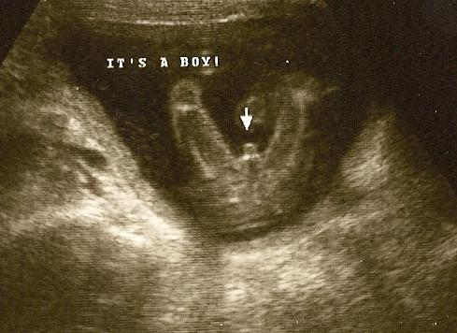
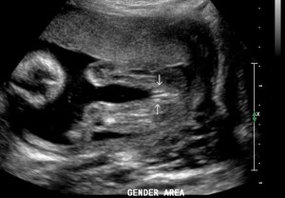
Second Trimester: Ultrasound
Anatomy Scan
  Checking brain, heart, kidneys, spine, stomach, bladder
  Checking placental location and amniotic fluid
  Optional: Is it a boy or girl?

Slide 14
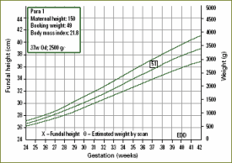
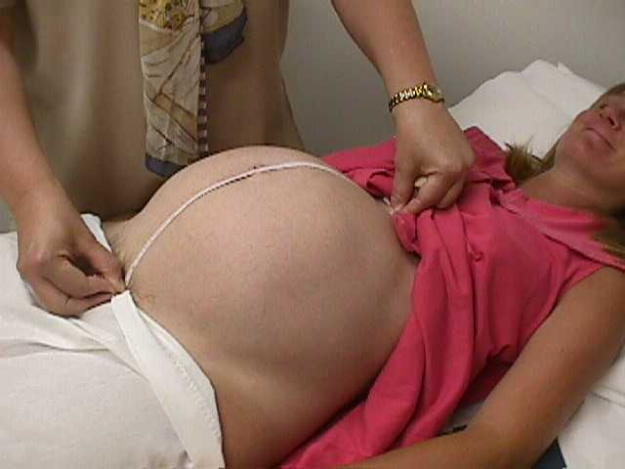
Third Trimester
Visits every 2 weeks until last month, which is weekly
  Blood Pressure
  Urine
  Weight
  Fundal Height

Slide 15
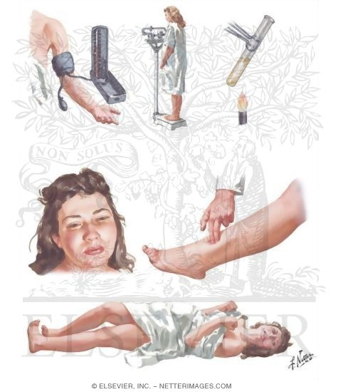
Third Trimester
Why so many visits?
  Pre-Eclampsia
    High Blood Pressure
    Proteinuria
    Abnormal Weight Gain
    Headache
    Swelling
  Eclampsia
    Seizures
    Stroke
    Death

Slide 16
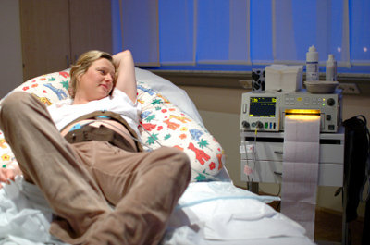
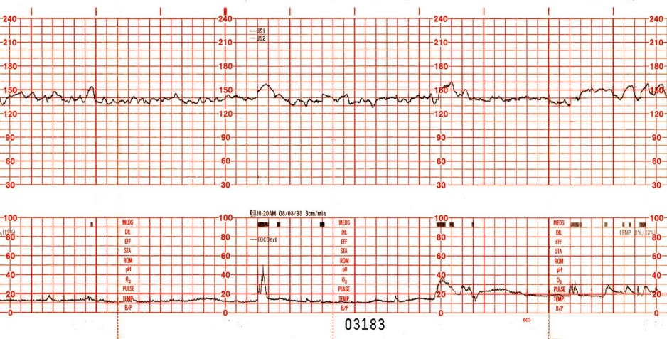
Pre-Eclampsia
Heightened surveillance
  For the mom—more frequent visits and blood work
    CBC, kidney and liver tests, urinalysis
  For the baby
    Ultrasounds for growth, fluid, and cord blood flow
    Fetal monitoring
      NST (Non-Stress Test)

Slide 17
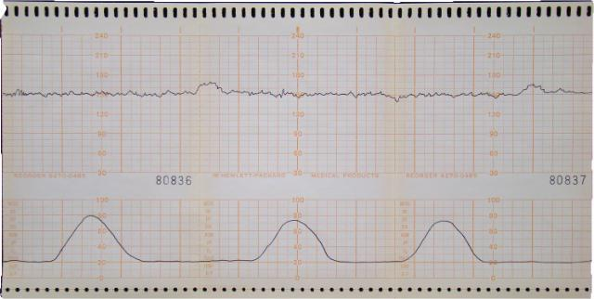
Fetal Monitoring
CST (Contraction Stress Test)
  OCT (Oxytocin Challenge Test)
  or
  Nipple Stim

Slide 18
Fetal Monitoring
BPP (Biophysical Profile)
  5 tests @ 2 points each = 10 points
    2 points for reactive non-stress test/heart rate
    2 points for adequate amniotic fluid
    2 points for gross body movements
    2 points for body movements (muscle tone)
    2 points for breathing
    →8-10 score = normal, healthy baby
    →6 score = equivocal, watch closely
    →4 or less score = abnormal, baby at risk

Slide 19
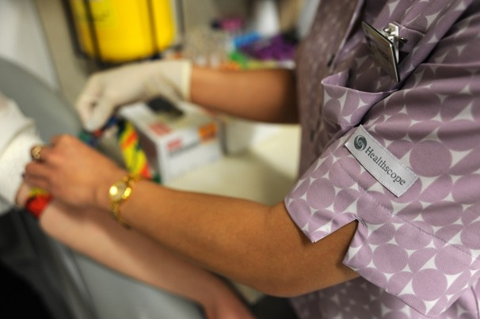
Labor and Delivery
Blood Tests for Mom
  CBC
  Blood Type and Screen—have available for mom
  PT, PTT (Clotting Test)
  Drug Screen
  Extras if Pre-Eclampsia, diabetic, hypertensive, etc.
Blood Tests for Baby
  From umbilical cord
  Blood Type
  Optional cord blood collection for storage
  Other tests, if indicated

Slide 20
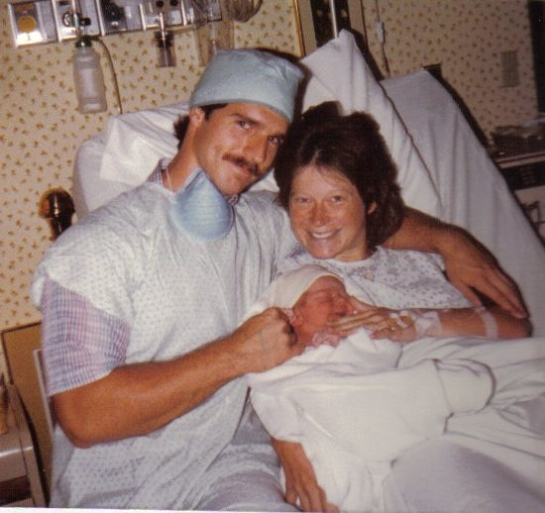
Conclusion

